Slide 1
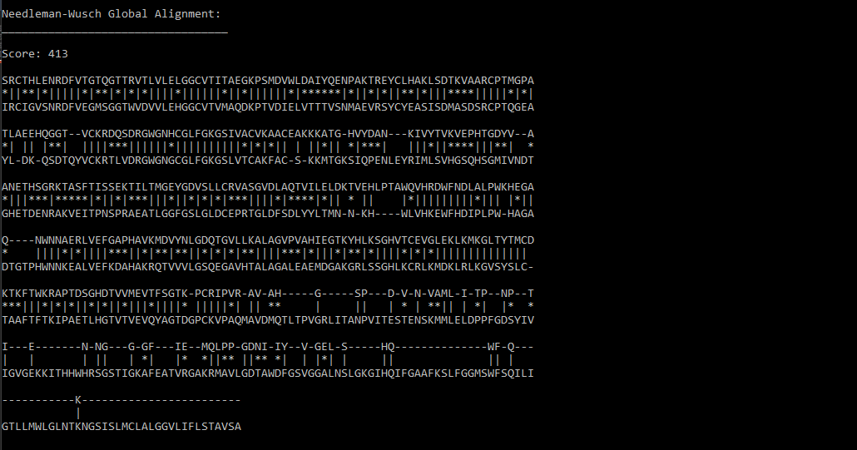
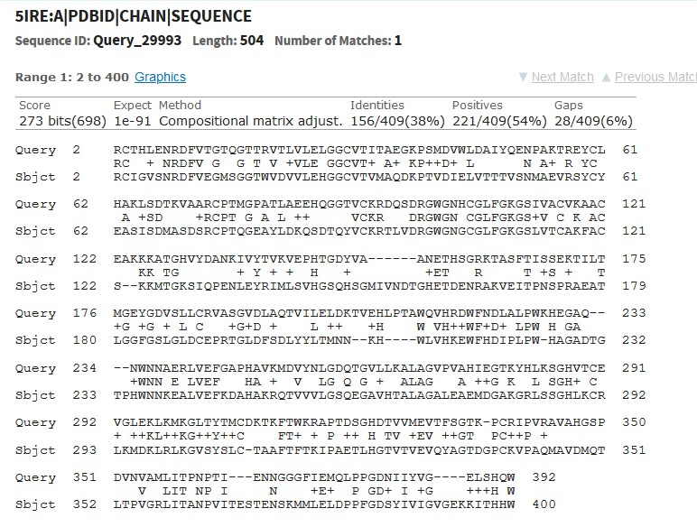
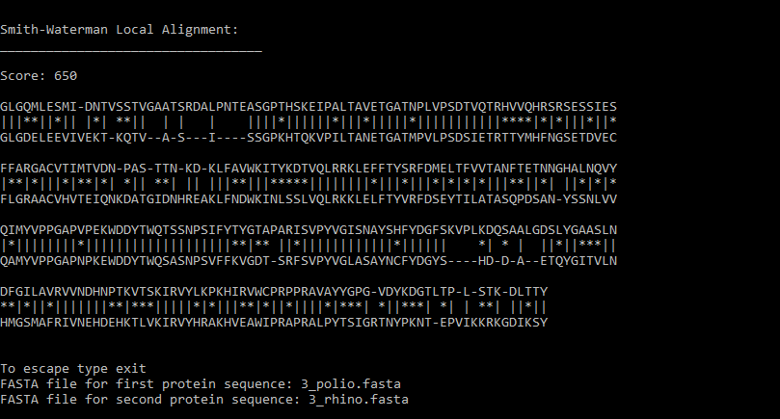
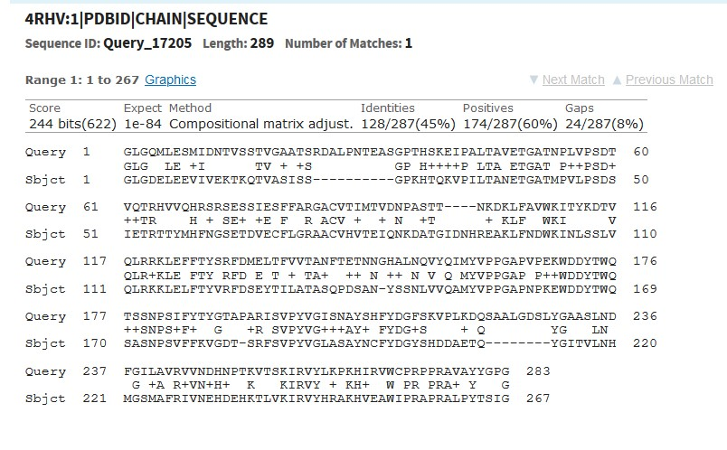
Alignment Scores
Dengue vs. Zika | Score: | Gaps:
Global: | 413 | 133
Local: | 778 | 36
BLAST: | 698 | 28
HIV vs. HPV | Score: | Gaps:
Global: | -540 | 258
Local: | 68 | 45
BLAST: | 37 or less | 1 or less
Polio vs. Rhino | Score: | Gaps:
Global: | 650 | 31
Local: | 650 | 31
BLAST: | 622 | 24
My Outputs
BLAST Outputs
Presentation by Sam Gass

